Slide 1
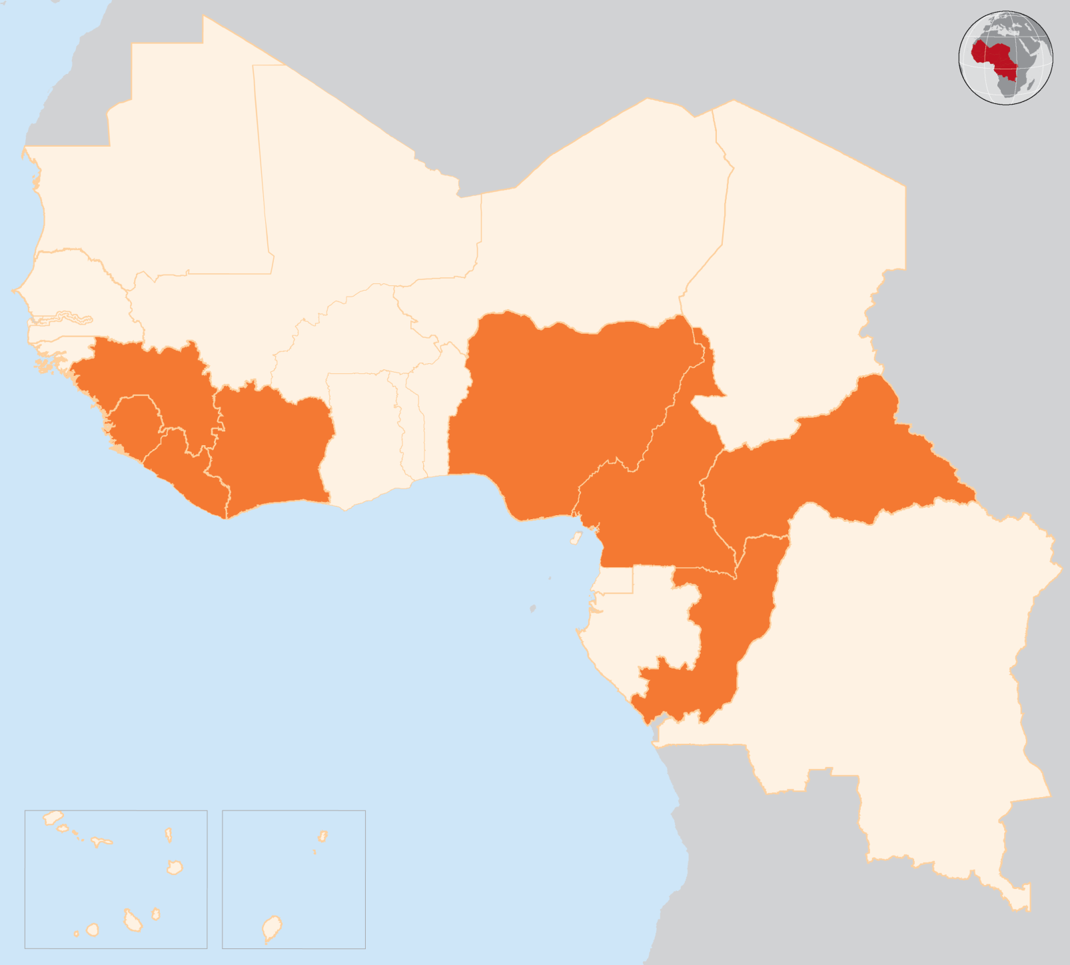

20 - 26 Oct 2015
CAMEROON
EIGHT PEOPLE KILLED AMIDST CLASHES BETWEEN BOKO HARAM AND THE CAMEROON ARMY
On 21 October, eight civilians were killed and nine injured in Doulo village, located in Cameroon's Far North region, during fighting between Boko Haram militants and security forces. In the region affected by violence resources are urgently needed to address protection issues, and further support is required in terms of access to health and psychological support.
BOKO HARAM BRIEFLY SEIZES CONTROL OF A TOWN ON THE BORDER WITH NIGERIA
On 23 October, Boko Haram insurgents briefly seized control of Kerawa, a town located in the Kolofata district in the far north of Cameroon, on the border with Nigeria. The assailants withdrew when the army arrived, according to Cameroonian security sources.
CENTRAL AFRICAN REPUBLIC (CAR)
UN RELIEF CHIEF RELEASES US$ 12 MILLION FROM CERF FUNDING
During a visit from 20 to 23 October, UN Relief Chief O’Brien released US$12 million from the UN Central Emergency Response Fund (CERF) to support life-saving assistance for people affected by the conflict in the Central African Republic, where more than 62,000 people have been displaced since new violence broke out in September. Emergency Relief Coordinator (ERC) Stephen O’Brien visited the Saint Sauveur IDP site and PK5 neighbourhood in Bangui, as well as the Dekoa area, where more than 10,000 people have recently been displaced. ERC O’Brien called for greater protection of civilians and sustained commitment to the CAR.
REPUBLIC OF THE CONGO
FOUR PEOPLE KILLED AND SEVERAL INJURED IN PRE-ELECTORAL PROTESTS
On 20 October, four people were killed and several injured in the capital Brazzaville, in protests ahead of the constitutional referendum.
LOW VOTER TURNOUT FOR CONSTITUTIONAL ELECTIONS
On 25 October, elections were held for a constitutional reform that would allow President Sassou-Nguesso to run again for president in 2016. Media reports indicated very low voter turnout at the polls. On 27 October, reports indicate that more than 92 per cent of voters, according to the results of the electoral commission, approved the change to the constitution.
COTE D’IVOIRE
ALASSANE OUATTARA RE-ELECTED, NO INCIDENTS REPORTED
Côte d’Ivoire's President Alassane Ouattara has won a second five-year term with nearly 84 per cent of the vote, electoral commission officials said on 28 October. On 25 October presidential elections were held without major incidents. One person had been killed in pre-electoral violence after the Constitutional Court released a list of ten candidates cleared to run in the election on 10 September. The voting is seen as crucial to turning the page on the 2010-2011 political crisis and a civil war that killed over 3,000 and displaced hundreds of thousands.
NIGERIA
AT LEAST 58 KILLED AND OVER 100 INJURED IN SUICIDE BOMBINGS
On 23 October, at least 55 people were killed, and more than 100 injured, in a suicide bombing at mosques in Maiduguri and Yola in the north-east of the country.
On 24 October, another suicide attack in Maiduguri killed three people and injured several others, according to media reports.
EVD REGIONAL
3 NEW CASES IN GUINEA, ALL KNOWN CONTACTS
Three new confirmed cases of Ebola were reported on 24 October in the village of Kindoyah, in the sub-prefecture of Kaliah, in Forecariah prefecture. All are known and followed contacts. Zero cases were reported in Sierra Leone and Liberia.
NIGERIA
58
KILLED IN SUICIDE BOMBINGS
CAR
UN RELIEF CHIEF VISIT
EVD REGIONAL
3
NEW CASES IN GUINEA
CAMEROON
CONGO
8
KILLED IN CLASHES
4
KILLED AND SEVERAL INJURED IN PROTESTS
COTE D’IVOIRE
PRESIDENTIAL ELECTIONS, NO INCIDENTS REPORTED
Creation date: 28 October 2015 Map data sources: UNCS, DevInfo, OCHA. Feedback: ocharowca@un.org
The boundaries and names shown and the designations used on this map do not imply official endorsement or acceptance by the United Nations.

